Slide 1
Face Recognition Solution Framework
Face Detection
Bounding +
Feature Extraction
Haar Face Cascade
Video Stream
OpenCV
Face Alignment
Face Detection + Face Alignment
KNN
MTCNN
Logistic Regression
Voting
Prediction
Face Representation
Refining + Encoding with 128 Feature Vectors
SVM
Dlib
HOG
MLP

Slide 2
Face Recognition Solution Framework
3 Targeted faces and >100 non-targeted faces are pre-processed using MTCNN (Background removal), and augmented.
As a result, ~100000 images are input into the system.
With the 128-byte code, it is now a smaller dataset which enables Classifier models to be trained for the final image recognition.
In this project, KNN, SVM, Logistic Regression and MLP are used to classify the 128-bit into certain person of Interest.
The output of each model is ensembled using voting system.
The whole system is able to make recognition in 0.2-0.6s depend on the CPU/GPU ran which is suitable to the mini server environment.
Notes:
[3] FaceNet: A Unified Embedding for Face Recognition and Clustering
Florian Schroff, Dmitry Kalenichenko, James Philbin
(Submitted on 12 Mar 2015 (v1), last revised 17 Jun 2015 (this version, v3))

Slide 3
OpenCV – Haar Cascade
Haar Cascade has 4 stages:
Haar Feature Selection (Not Haar Wavelet)
Creating Integral Images (Allows multiple Haar features to be determined across the image)
Adaboost Training (Boosting method, ensemble on weaker convolutional classifier using Haar Feature as kernel. Pre-trained using positive and negative images)
Cascading Classifiers (Stages of Adaboost classfier. Determine the strongest image region than resemble the face)
Notes:
[3] Theory: https://medium.com/@ageitgey/machine-learning-is-fun-part-4-modern-face-recognition-with-deep-learning-c3cffc121d78
Github: https://github.com/ageitgey/face_recognition

Slide 4
MTCNN
What is MTCNN?
MTCNN or Multi-Task Cascaded Convolutional Neural Network is used for face landmark detection and face boundary detection.
MTCNN has 3 stages of convolutional neural networks namely, P-Net (Proposal), R-Net (Refine) and O-Net (Output)
Best bounding coordinate and 5 face landmark coordinates are selected.
Why use MTCNN?
Giving position of face landmark in fast speed. It can re-align the faces so the eyes are in horizontal axis. It reduces the rotation of images in the augmentation process. Hence, MTCNN alignment is used during both training and testing stage.
MTCNN realignment is faster than DLIB. Hence using MTCNN at image pre-processing.
Notes:
[3] Theory: https://medium.com/@ageitgey/machine-learning-is-fun-part-4-modern-face-recognition-with-deep-learning-c3cffc121d78
Github: https://github.com/ageitgey/face_recognition

Slide 5
Dlib – HOG Face Encoding
Face encoding is done through face_recognition python library developed by Ageitgey. This library is mainly based on open source Dlib.
Face_recognition library return result in 128-bit code and hence suitable for face encoding.
Face_recognition has several steps to refine and encode the face image:
face detection using HoG (further refine bounding area from MTCNN in this project)
dlib face landmark detection and face projection
neural network trained using triplet loss for error computation
Notes:
[3] Theory: https://medium.com/@ageitgey/machine-learning-is-fun-part-4-modern-face-recognition-with-deep-learning-c3cffc121d78
Github: https://github.com/ageitgey/face_recognition

Slide 6
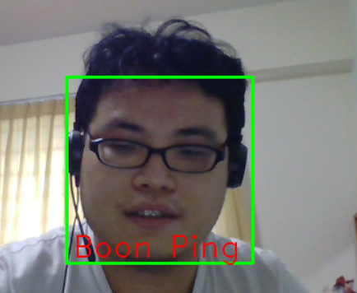
Samples Used
100+ Samples
Augmentation
Change lighting by changing gamma to 0.8/1.2
Images are filtered using Laplacian of Gaussian
Images are filtered with Gaussian Blur
Images are zoomed in or zoomed out
Images are rotated right or left up to 15 degree
Images are flipped horizontally
100K Samples

Slide 7
Face Recognition – Complication
Multiple faces can be taken into an image frame at the same time.
Lighting can be different in between testing ground and training ground. Bright lighting (which is mainly yellow lighting that has significant R and G component) can reduce the contrast in between face and surrounding environment. Face area which is not exposed to the light may not be recognized.
Though targeted face is known, the application ground is an open space that allow free movement. Hence, accuracy varies between individual visitor.
For the targeted face, not all facial expression/hair style can be captured. Spectacle effect can also be extra factor to the recognition accuracy.

Slide 8
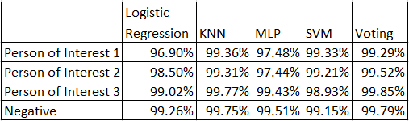
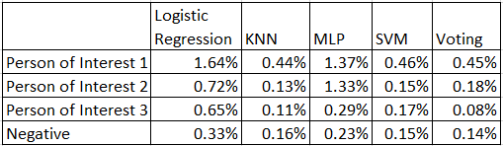
Performance
Accuracy
False Negative

